Slide 1

Master Curriculum Blockchain Technology & Cryptocurrencies
www.generationblockchain.eu
2022-2024
OERS
By
Frankfurt School of Finance & Management

Slide 2

01
MODULE 5
Fundamentals of
Coding & Programming
Funded by the European Union. Views and opinions expressed are however those of the author(s) only and do not necessarily reflect those of the European Union or the National Agency. Neither the European Union nor National Agency can be held responsible for them.

Slide 3
contents module 5
01
Introduction to Smart Contract Coding
113
02
Learning Assessment For Module 5
114

Slide 4

01| MODULE 5 Fundamentals of
Coding & Programming
Chapter Overview
Learning Objectives
In this module, you will be introduced to the programming language Solidity and the concept of building smart contracts and decentralized Apps.
After the first module, you should be able to:
Learn how to program a game on Ethereum.
Learn and use basic solidity concepts.
Understand and deploy ERC721 & crypto collectibles.
Understand and be able to program app front ends & web3.js.
Understand how data feeds and computations work theoretically and in practice.
Learn how to deploy dApps with Truffle.
Learn how to build an Oracle.
Test smart contracts with Truffle (e.g., using Chai to write more expressive assertions, testing against Loom).
Learn how to deploy on TRON, one of the fastest-growing public blockchains.
Understand the basics of zkSync.

Slide 5

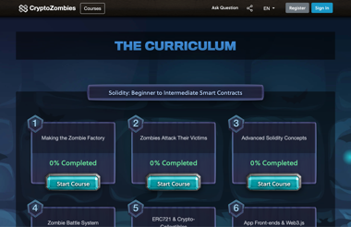
01| INTRODUCTION TO SMART CONTRACT CODING
As programming is best learned through doing it, head over to the Solidity course “CryptoZombies” where you will be guided through deploying your own smart contracts once you have a good understanding for the basics. CryptoZombies is a free, open-source, interactive code school that teaches you to build games on Ethereum. The course is designed for beginners to Solidity and starts off with the absolute basics. Click here.
CLICK TO VIEW
During the “Solidity: Beginner to Intermediate Smart Contracts” section, you will learn:
How to build a game on Ethereum
Basic solidity concepts
ERC721 & crypto collectibles
App front ends & web3.js
During the “Chainlink: Decentralized Oracles” section, you will learn:
How data feeds and computations work
During the “Advanced Solidity: Get In-depth Knowledge” section, you will learn:
Deploy dApps with Truffle
How to build an Oracle
Testing Smart Contracts with Truffle (e.g., using Chai to write more expressive assertions, testing against Loom)
During the “Beyond Ethereum: Explore the Blockchain Ecosystem” section, you will learn:
The basics of zkSync
During the “Tron: Decentralize the Web” section, you will learn:
How to deploy on TRON, one of the fastest-growing public blockchains

Slide 6
02
LEARNING ASSESSMENT FOR MODULE 5

Slide 7

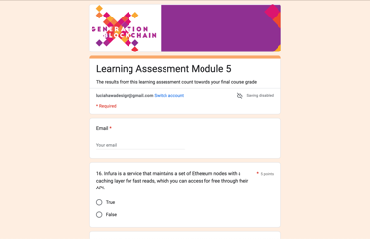
To test your knowledge, finish this learning assessment as part of your overall grade for the course.
Click here.
CLICK TO VIEW

Slide 8



follow your journey
www.generationblockchain.eu

