Slide 1

Master Curriculum Blockchain Technology & Cryptocurrencies
www.generationblockchain.eu
2022-2024
OERS
By
Frankfurt School of Finance & Management

Slide 2

01
MODULE 2
Trust in Business
Funded by the European Union. Views and opinions expressed are however those of the author(s) only and do not necessarily reflect those of the European Union or the National Agency. Neither the European Union nor National Agency can be held responsible for them.

Slide 3
contents module 2
01
The Role & Means For Trust In Business
38
02
Application Areas of Blockchain Technology
50
03
Learning Assessment For Module 2
56

Slide 4

01| MODULE 2
Trust in Business
Chapter Overview
Learning Objectives
In this module, the role and means for trust in business (i.e., measurement & processes for trust establishment) and how blockchain technology can redress the establishment thereof are discussed. Further, the module presents different application areas of blockchain technology such as financial and industrial use cases.
After the second module, you should be able to:
Argue the importance and prevalence of trust in business.
Understand the different dimensions of trust.
Explain how blockchain technology can enhance trust in certain business processes and fields.
Understand the prerequisites to place trust in cryptocurrencies and factors influencing this trust.
Explain which group(s) of people trust cryptocurrencies.
Reiterate various financial use cases for blockchain technology and their benefits and pitfalls.
Reiterate various industry use cases for blockchain technology and their benefits and pitfalls.

Slide 5
01| THE ROLE & MEANS FOR TRUST IN BUSINESS
1.1 Measurement & Processes for Trust Establishment
Trust occurs without exception in all business-related activities and scenarios. In fact, it is the foundation of all activities, deals, collaborations, and processes that involve more than one party. In a business context, trust is required with people from inside or outside of the organization. While it is hard to quantify the precise importance of trust, a lack of trust is arguably one of the biggest expenses in business. Trust is a particularly fragile concept, given that it may take years for a manager or an executive to develop the trust of their employees, but can be betrayed within a moment. Trust is the natural result of thousands of tiny actions, words, thoughts, and intentions. Without trust, transactions would not occur, influence could be destroyed, leaders can lose their teams and salespeople can lose sales.
What is Trust?
Trust is a(n) (at least) two-party bilateral social construct that is built when perceived risk and consciousness of vulnerability are outweighed by the perceived benefit that both (or more) parties choose to see before going forward in acting on their intentions. It is a manifold concept made up of thousands of tiny actions, words, thoughts, and intentions. Despite the central role of trust in business today, it can remain unnamed and invisible.
The business strategist David Horsager identified the following eight pillars of trust:
1
5
Clarity
People trust the clear and mistrust the ambiguous
Commitment
People believe in those who stand through adversity
2
6
Compassion
People put faith in those who care beyond themselves
Connection
People want to follow, buy from, and be around friends
3
Character
People notice those who do what is right over what is easy
7
Character
People immediately respond
to results
4
Competency
People have confidence in those who stay fresh, relevant, and capable
8
Consistency
People love to see the little things done consistently

Slide 6

As per “PwC’s Trust in US Business Survey” from 2021, business executives, customers and employers show to think about the same four items when they think about trust: data protection, cybersecurity, treating employees well, ethical business practices and admitting mistakes. Notably, when it comes to points beyond these four elements, the divergences grow. Business leaders tend to take a broader stance on trust including elements of responsibility such as responsible usage of artificial intelligence (AI) and social impact (i.e., sustainable value chain management and ESG reporting). Employees, on the other hand, emphasize more on leadership accountability. This survey merely serves as a benchmark that gives an idea of how much the notion of trust differs depending on socio-economic, demographic, and personal definition. The only statement regarding trust in business that can be made with certainty is that it is a highly complex phenomenon that is yet to be fully understood.
According to the PwC study, established trust in companies pays off in several ways and through various stakeholders: Almost half (49%) of consumers have started or increased purchases from a company because they trust it, and 33% have paid a premium for trust. PwC finds that 44% of customers have stopped buying from a company due to a lack of trust. As for employees, PwC finds that 22% have left a company because of trust issues and 19% have chosen to work at one because they trusted it highly. In other words, one out of five of your employees do not leave for reasons of a higher-paid job or position but because of a lack of trust in the company.
Next to the already mentioned points of data protection, cybersecurity, treating employees well, ethical business practices, and admitting mistakes, customers deemed data protection to be a determinant of trust placed in a company. Data protection is perceived as a necessity and considered the bare minimum for trust not to falter. In a break between theory and practice, business leaders’ actions on trust often do not match what they deem “extremely important”, and these actions often are not addressing consumer priorities. For consumers, the top trust driver is accountability, while only 56% of business leaders deem it to be “extremely important.” Only 46% say that their companies have implemented it.

Slide 7
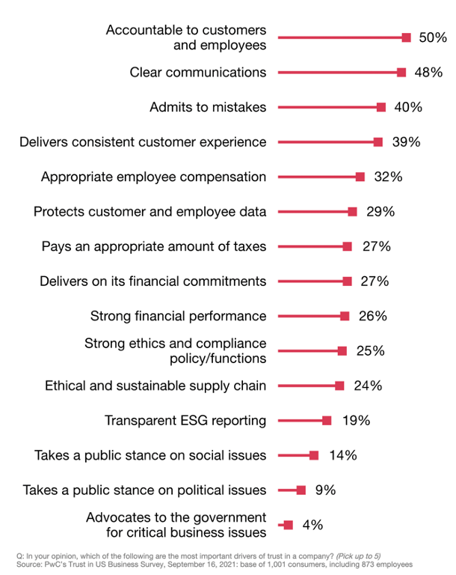
What builds trust in business for consumers and employees
Figure 7: What builds trust in business for consumers & employees
(Source: PwC’s Trust in US Business Survey, 2021)
When it comes to environmental, social and governance (ESG), 45% of business leaders have implemented transparent ESG reporting — but only 19% of consumers list it among the top five drivers of trust. This disconnect between consumers and businesses may be more complex than it first appears. Consumers care deeply about ESG initiatives such as climate change. However, they may not fully understand what ESG reporting entails, or PwC alternatively supposes that customers may consider it as part of their top two trust drivers (i.e., accountability and clear communications). ESG skepticism may also be a problem. Only 24% of consumers say the main reason for ESG pledges is to do good. Far more (39%) say that the motive for companies lies in self-interest: to build trust with the consumers.
In this next section, a narrower look will be taken at e-commerce trust.

Slide 8

Trust in E-Commerce
With the rise of e-commerce, the concept of consumer trust has been adopted, analyzed, and refined in its meaning and role in the online context. This is to say that different additional layers of complexity have been added to the already diffuse concept of trust in offline business contexts. This particular kind of trust is called online trust and refers to the attitude of the customer which has the confident expectation in an online situation that one’s vulnerabilities will not be exploited. E-tailing websites convey more and more humanistic qualities which mimic its retailing equivalent with actual human interaction to foster trust- building. Though there is no pertinent scholarly definition for consumer trust, the elements of confidence in a product or company, assurance for integrity, and reliability are often named in association.
In e-commerce, the importance of the website’s design and social cues that convey humanlike features as well as the assurance of transaction are builders for trust in businesses. Further, security, privacy protection, and knowledge-based familiarity of the website and its functions have been found to have a positive as well as significant impact on trust.
Overshadowing all that an online vendor can regulate within his/ her sphere of influence is self-efficacy (i.e., initiation, effort, and persistence of the customer). Self-efficacy assesses how well someone can go through a course of action that is needed to deal with a prospective situation, regardless of the actual skill level of a person. It puts other antecedents for trust in the shade in terms of positive influence on transaction trust. Meaning that if a user cannot navigate well through e-commerce, their trust in the e-commerce shop or is impaired as a result even if the skills of the user play a large role in the impairment. With millennials, there is a relatively high perceived risk associated with online purchases as compared to younger generations. Possible incentives that are perceived benefits in the eyes of the customer entail time and cost savings and increased convenience
Concerning benefits, functional benefits rather than affective trust-based ones are found to influence purchase intention the heaviest in multiple studies. Especially the first two named elements can be connected to cryptocurrencies since their transaction time and cost is lower than with alternative payment service providers. For example, a retailer in the USA selling a product via PayPal costs 2.9% of the sum sent plus $0.30 per transaction within the country. Border crossing trades cost an additional 1.5% of the transaction settling sum. BitPay as a comparable payment service provider in the crypto sector charges only 1% of the sum, regardless of border crossing. This example can be seen as an incentive for the customer and the retailer because, for both sides, the transaction becomes cheaper and thus, more beneficial. The more prevalent the perceived benefit is in the mind of the customer, the more willing he/she is to share their sensitive data. Several studies show that even individuals that are highly concerned with their private data are by a vast majority willing to share their data nonetheless, if they value the product, trust the brand, are offered reward points or other financial incentives. These aspects can often be seen in loyalty point schemes and member rebates. As soon as it is established as initial trust, continuous consumer trust and perceived benefits can be seen as a mental shortcut. Together they serve as a mechanism to reduce transaction- specific uncertainty and influence payment behavior and choice of payment methods. Payment behavior can be broken down from manifold starting points. From country to age, occupation over gender, and financial education-specific segmentation, differences can be pointed out.

Slide 9

1.2 Blockchain Technology for Trust Establishment
First of all, it is important to note that blockchain technology is not a trustless technology but rather a confidence machine. The absence of a trusted authority in charge of managing and coordinating interactions over a blockchain-based network does not make it a “trustless technology”. In fact, while trust is less relevant when it comes to the standard operations of a blockchain-based system, it is nonetheless necessary to trust the actors securing and maintaining the underlying blockchain network, to guarantee a sufficient level of confidence in any of the blockchain-based applications operating on top of that network. Blockchain technology thus produces confidence (and not trust) in blockchain-based systems based on the user’s understanding of procedural and rule-based working, stemming from derived mathematical knowledge and cryptographic rules and mechanisms and long-standing account of its past performance. It increases confidence in the operations of a computational system which is dependent upon its underlying governance structure. To place confidence in the governing party or parties of the computational system, trust in a distributed web of actors is needed.
To place trust in a distributed web of actors the following questions need to be answered:
1
2
Is the system governed properly?
Can the various actors involved be expected to act in accordance with the blockchain system’s rules?
The web of actors includes miners and mining-pools, responsible for processing and validating transactions, large commercial operators, such as cryptocurrency exchanges or custodian wallet providers, who can leverage their market power to unilaterally impose their decisions onto their user-base, as well as core developers and social media influencers, whose voice can contribute to shifting the selling point. Regulators and policy makers also have a role to play in the governance of blockchain-based systems, to the extent that they can introduce legal restrictions and constraints to influence the decisions taken by any of these actors.

Slide 10

The governance of most blockchain-based systems has been constructed in such a way as to distribute trust over many actors, with different interests and preferences, so that no single actor has the capacity to unilaterally affect or influence the operations of the overall network. Problems emerge, however, when standard governance practices are threatened in the case of an emergency that calls for decision-making beyond the scope of ordinary procedure (e.g., as in the case of TheDAO attack on the Ethereum network).
Although it is possible to enhance confidence in the proper operations of blockchain-based systems through the introduction of a series of technological guarantees related to on-chain governance, the robustness of the underlying governance system requires a whole different set of constraints that extend beyond the scope of a purely codified protocol and code-driven rules. Hence, in order to ensure a proper level of confidence in such blockchain-based systems, it may be necessary to introduce a series of procedural and substantive constraints related to off-chain governance, addressing both situations of normalcy and states of exception.
If we take another look at David Horsager’s eight pillars of trust, the following theoretical statements for blockchain technology can be derived:
1
Clarity
People trust the clear and mistrust the ambiguous
Data inserted into a blockchain is clear, transparent, and immutable. It is clear where data is coming from and how and under which parameters it was inserted into the blockchain system and keeps the same record of a ledger no matter which user looks at it.

Slide 11
2
5
Compassion
People put faith in those who care beyond themselves
Commitment
People believe in those who stand through adversity
Blockchain as a neutral technology cannot assert compassion unless programmed to do so (i.e., act according to rules and code)
Decentralized and censorship-resistant blockchain technology cannot be altered and is committed to a truthful display of reality as fed into the blockchain at a given point in time. Changes made throughout time in a blockchain can be tracked and pinned down.
3
Character
People notice those who do what is right over what is easy
6
Consensus mechanisms incentivize miners, validators, nodes, developers, and participants in a network to do what is right over what is easy. Doing what is right over what is easy is thus not the easier way but the only way in a blockchain-based system
Connection
People want to follow, buy from, and be around friends
Though blockchain technology is a neutral technology and does not have the ability to build interpersonal connections with its users in the case of cryptocurrencies there is communities building around a network that can act as interpersonal relationships to one to follow by from and be around as well as learn from. Crypto communities often share the same vision and mission for a cryptocurrency project they also often collaborate on projects together giving a feeling of belonging.
4
Competency
People have confidence in those who stay fresh, relevant, and capable
In a sense blockchain technology is an iteration step of digitalization and digitization at the same time. While digitalization is referring to making processes such as sending money digital digitization means moving real-life objects onto a blockchain and making it thus digital, tradable, and divisible. blockchain systems can be seen as more relevant and capable than many other innovative technologies.
7
Contribution
People immediately respond to results
In the case of cryptocurrencies and permissionless blockchain systems people can immediately participate and contribute to the network and the protocol.

Slide 12


8
Consistency
People love to see the little things done consistently
As the rules of a blockchain system are set out from the beginning and cannot be altered unless a 50% majority is reached blockchain technology can be considered consistent by nature. depending on the network many blockchain systems are up and running 24/7 which can also be viewed as a means of consistency. Though there are improvement proposals in blockchain systems to change rules as needed blockchain systems generally stay consistent in that they are often times backward compatible with previous versions of the system or alternatively they create spin-offs of an existing blockchain (a so- called fork).
Three Measurable Areas of Trust
In 2018, PwC’s conducted the Global Blockchain Survey which found that 45 percent of companies investing in blockchain technology believe that lack of trust among users will be a significant obstacle in blockchain adoption. Reasons provided for this assessment include uncertainty with regulators and concerns about the ability to bring business networks together. PwC makes suggestions to close this trust gap early by planning cybersecurity and compliance frameworks that regulators and stakeholders will trust from the initiation of blockchain development within a company.

Slide 13
Looking at data from supply chain networks across the retail industry, PwC identifies three key measurable areas often considered the foundation of enterprise trust:
1
Validity of data
An organization has, to the extent and to the effect, accurately sourced information that holds true when shared with the consumer.
2
Governance of data
An organization has defined fair business rules to manage data and to align with business processes.
3
Reliability of data
An organization acts consistently and proactively, in a timely, thought-driven manner.
Generally speaking, enterprises tend to hesitate to embrace emerging technology, especially one that requires a new method in sharing data which blockchain technology would require them to do. Blockchain technology delegates data management back to the consumer and to regulatory bodies. Blockchain Technology cannot only shift trust mechanisms within single business entities but rather in whole industries. For example, in supply chain management. The more companies embrace blockchain, the more networking effects come into place. Supply chain management on-chain can only make sense if all steps along the chain are tracked by all participating parties. As soon as one or more steps and suppliers are not participating, the chain is incomplete and significantly inhibited in its purpose.
With more than a decade of this transformative technology, through the rise of digital commerce, trusting business networks have raised significant questions in transforming IT. As a result, this transformation has redefined technical stacks and has developed new data models. However, technology cannot scale trust within a transaction, hence, to reduce the cost of trust, PwC identified quantifiable metrics in the scope of their study.
Quantifying Trust
Today, blockchain presents an interesting predicament in corporate America with businesses siloed by traditional infrastructures and long-standing processes. With the rise of blockchain technology, businesses are demanding data quality reviews prior to progressing into solutions that apply automated business logic across a value chain. Another issue is presented by the quality of data that is inserted into a blockchain system by an oracle. A so-called oracle is the source of inputs from the real world, oracles thus connect blockchains to external systems.

Slide 14
Although trust is a qualitative attribute, the measure of trust depends on quantifiable metrics. Quantifiable measurements of trust as identified by PwC include:
1
System behavior
Programs and applications that capture the movement of data, as exhibited by transactions, consensus, or votes.
3
IoT & digital identities
IoT devices, QR codes, and web-based identities for cybersecurity.
2
Content analysis
Using techniques like Natural Language Processing (NLP), deep learning and AI/ML to analyze structured and unstructured data.
4
Social layer
Considering human actors, social aspects, user incentives and
motivations, culture, levels of digital literacy, access to technology.
By capturing quantifiable data, enterprises begin to establish governance with a collection of automated business processes, improving regulatory compliance and safeguarding the customer experience. The expansion of blockchain data depends on the migration of enterprise legacy data into building blocks, defining rules for each block that results in enhancements to business outcomes as measured by revenue, customer satisfaction, leaner processes, and automation of manual processes.
Blockchain in the Public Sector
Developing blockchain solutions for the public sector also requires a decision for the blockchain stack. The main issue to solve in the public sector is social trust by the public. To increase trust in the public sector, it needs to be considered which information needs to be captured and stored in the blockchain as well as which information should not be included. In the permanent record to support the goal of trust. This is then followed by consideration of the blockchain protocols, architectures and other technical considerations that deliver the necessary capabilities.
A choice must be made regarding the distributed ledger technology protocols (i.e., Ethereum, Hyperledger, Corda, Quorum), the network options (e.g., public, private, hybrid or consortium), governance mechanisms, security, and cost/duration indications (initial investment and annual operating costs).
In this approach, the initial three-layer design and implementation paradigm is expanded by the social layer (i.e., human actors, social aspects,
user incentives and motivations, culture, levels of digital literacy, and access to technology).
Adopting this approach encourages consideration of important design trade-offs among the layers that could help avoid potential misalignments between the technology and its intended area of application, as well as encourage faster adoption and more transformative outcomes for governments.
1
A data layer
The ledger itself is an ”immutable” store of transactional data and/ or records, including considerations of data usability, privacy, and security, authenticity,
reliability, integrity, etc.)
2
A technical layer
The technology stack, including distributed ledger protocols, consensus mechanisms, architectures, peer-to-peer networks, data storage, etc.

Slide 15
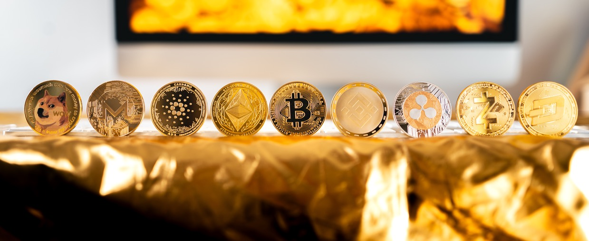
Trust in Cryptocurrencies
After having looked at trust in the context of blockchain technology, we will now focus on trust in cryptocurrencies specifically. As there is no single entity behind Bitcoin that can help with customer service requests, a user that holds their Bitcoin in self-custody, can in the event of losing their keys for access to their Bitcoins not be recovered in any way. In a sense, instead of trusting payment service providers, trust is replaced upon the payer holding their own cryptocurrency.
There is evidence that trust in an algorithm is more likely when information on others who have adopted it already is available rather than the actual accuracy of an algorithm. Anecdotal evidence and reviews from people that we know, and trust can be a bigger driver of trust than the factual accuracy of an algorithm’s working mechanisms. In the case of blockchain technology, this could mean that anecdotal evidence of people or executives we trust could make us more likely to place trust in the technology. There are different attributes that impact trust in cryptocurrencies. Trust is found to be linked to transferability, immutability, and openness. Cryptocurrencies, such as Bitcoin, could make international transfers much easier, with lower transaction fees than those charged by traditional commercial banks. Since cryptocurrencies could become an alternative method for international money transfers, several commercial banks worldwide are looking into launching their own cryptocurrencies.
Other trust-fostering factors are ledger immutability and openness - the former securing safe and fair transactions and the latter making the transaction information accessible to the public. Immutability means that the transaction
history provided on Bitcoin ledger cannot be manipulated, revised, or deleted. Openness refers to the availability of the data on the Bitcoin blockchain to everyone, rendering the system completely transparent. Openness creates transparency, while immutability creates accountability. Transparency is considered as the key element in trust creation. The degree of transparency and accountability offered by Bitcoin or other cryptocurrencies is unparalleled to that of any traditional financial institution. When technology provides a high enough level of transparency and accountability, it eliminates the necessity of a trusted central authority to govern the system. In other words, it is essentially the core properties of blockchain technology that facilitate the creation of trust in cryptocurrencies.
The geographic locations in which crypto communities are is also where crypto hubs are forming (i.e., through the founding of crypto or blockchain technology-enabled companies, providing point of sales for cryptocurrencies in stores are more frequent, laws and regulations are laxer). These individuals meet the criteria of being at least somewhat knowledgeable and familiar with cryptocurrencies. Exemplarily, Berlin has a district in which almost all stores accept cryptocurrencies as a means of payment, the IT University of Copenhagen offers a Blockchain summer school, in 2018 the Czech Republic counted 147 Bitcoin-accepting stores in 2018 and Malta is also referred to as Bitcoin Island.
It is not possible to assess trust in cryptocurrencies fully as it consists of various layers, angles, and depends on the technical set-up, jurisdiction and what cryptocurrencies are used for.

Slide 16


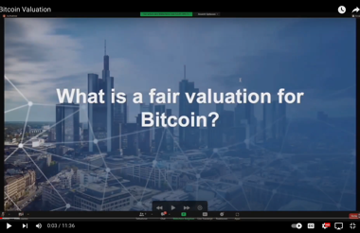
Who trusts Bitcoin?
Trust in Bitcoin as a means of payment and investment vehicle is more prevalent in segments that fit the profile of male, between 20 and 35, are financially well-educated, and have high levels of self-efficacy in handling crypto payments. The adoption of blockchain technology is measured by how well it is understood and trusted.
Lack of knowledge is found to significantly limit trust and usage intention. Another trust influencing factor is the reinvolvement of a third-party payment service provider. It does not necessarily mean that by introducing a payment service provider, Bitcoin’s features lose their trait of being perceived as a trustless system. It can be even beneficial for building trust to have a tangible contact company. In terms of functional benefits, retailers can mitigate volatility risk and shift the financial risk connected to Bitcoin. To sum up, it depends heavily on the convictions of individuals whether increased trust in cryptocurrencies is achieved by reintroducing a third party or by removing the third party.
Established trust in existing payment methods does not significantly influence usage frequency (for example ApplePay, PayPal, etc.). Trust also does not appear to be an irrefutable prerequisite for usage, especially not for payment methods that customers are completely unfamiliar with and thus, hold a higher perceived risk of uncertainty. Bitcoin does fulfill the requirements of acting as a payment method in that it has comparable features such as trustworthiness, transaction speed, cost, crossing international borders, etc. to other existing payment methods. Even though initial trust in Bitcoin as a payment method is not established with most people, it does not mean that Bitcoin as a payment method would only be used by those that trust it. Trust in Bitcoin in general and trust in Bitcoin as a payment method are two different things where trust in one does not necessarily imply that trust in the other is established as well, though there is a tendency that those who do trust Bitcoin also trust it as a payment method.
To gain an understanding of what a fair valuation for Bitcoin is, watch this Generation Blockchain video.
CLICK TO VIEW

Slide 17
02
APPLICATION AREAS OF BLOCKCHAIN TECHNOLOGY

Slide 18

2.1 Financial Use-Cases
Stock market trading itself has already undergone a disruptive change in the recent past. Electronic trading, clearance and settlement systems have against what was believed previously not really eliminated jobs on the trading floor. Rather, only some regional exchanges have become unprofitable and insignificant, and with them and, as a result, a number of professions. This innovation has led to an enormous increase in efficiency in stock exchange trading. As a result, trading volumes and turnover have increased, transaction costs have decreased, and new exchange products and jobs have been created. The significance of the world's leading stock exchanges has increased the technological revolution. For this reason, further efficiency gains for example through blockchain technology in secondary trading and settlement are likely to be unpromising. Other areas of application for blockchain technology promise greater innovation potential and thus higher profits.
Issuing securities
The issuing process of securities on the primary market for example is currently still costly and complex. Blockchain technology could generate effects similar to those of electronic trading for the secondary market. The Bank of the State Baden Württemberg (LBBW) in Germany and Daimler AG have issued a prototypical bond with blockchain technology as pioneers. This indicates that the efforts to develop applications with added value are being intensified not only among FinTechs as is often believed. One application that has already widespread application are so-called initial coin offerings
(ICO). The similarity in name to an initial public offering (IPO) is not coincidental with the issuance of shares on the primary market. An IPO in the analog market is lengthy and costly since many disclosure requirements and stock exchange regulations must be complied with. It, therefore, made sense to use the instrument outside of regulation in the digital world to raise capital. As an example, one can now delineate from the ICO's how the incorporation (or subjection) of these issues into financial regulation is taking place. If necessary, the authorities are also prepared legally to enforce equal treatment.
Electronic payment & business processing
Another area of application for blockchain technology is electronic payment and business processing. This involves both, the more efficient of conventional payment transactions as well as the replacement of business processing. The advantages of blockchain technology should be the speed, security, and trustworthiness of processing. In leading industrialized countries, especially the European Union it should be difficult to compete here with the European System of Central Banks (ESCB) in international payments. In contrast, blockchain may find high acceptance in economic regions with trust deficits, security gaps, and/or inefficient payment processing. However, this advantage will only come to fruition if there are numerous interfaces and bridges to the real world exist.

Slide 19

This requires the affordability of goods and services of all kinds with cryptocurrency. It is rather unlikely that this will be the case in, of all places, countries or regions where traditional payment systems and other innovations are not yet established. The Bundesbank and the ECB, in monitoring blockchain developments and the digital currency markets have so far concluded that the processes and costs of their systems are significantly more efficient and cost-effective. Nevertheless, both institutions are also testing blockchain technology in order not to miss out on new developments, if necessary. Another potential savings from blockchain technology, which could result from the lack of regulatory and financial oversight costs for this type of payment processing, is only true as long as the number of payment flows is not systemically relevant.
Payments Across Borders
Multinational banks such as UBS and British Barclays use blockchain to streamline back-office operations and settlement, which could potentially decrease US$20B expenses for third-parties involvement. For example, in 2019 Barclays invested US$5.5 million in startup called Crowdz that helps businesses to promote B2B cash turnover. As a result, it offers alternative ways of payment collection and automation of e-invoices. Another renowned Spanish bank has cooperated with the DLT-based company to add visibility to their international payments and dramatically accelerate them.
Pressured adoption of blockchain technology
If, on the other hand, they have reached a significant scale and would be used across the board to pay for goods and services, these services would not be concealed from financial supervision. At the latest, regulation would then be created. Blockchain activities in the financial system that remain outside of regulation would then, at best, have the meaning of a black market and would then, if necessary, also be relevant under criminal law.
New business models
The potentially most promising application of distributed transaction registers is to be seen in the linking of banking transactions and real economic business processes. Broader use of pay-per-use processes, real-time settlement of transactions in value chains and cash-flow-oriented corporate financing with smart finance can be expected. These represent new services whose forms of financing will be digital and automatized. Their settlement does not necessarily require an artificial currency. On the contrary, virtual currencies will be able to conquer this market as a payment medium only if transparency increases, fraud disappears, and value stability is established and controlled. In any case, this will further revolutionize the financial services business. In addition to FinTechs, which are often the focus of attention, and which are using innovative solutions to drive the competitors with innovative solutions, established financial service providers are also experimenting with digital process solutions. They have the advantage here, of the functionality, security, and costs of the existing systems and processes and can leverage this expertise.

Slide 20
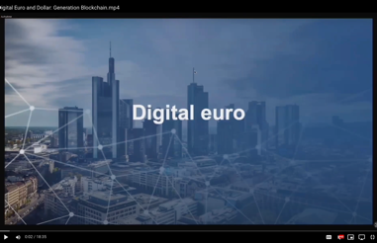
Cost reduction
One motivation for the development of distributed ledger applications in the Finance arises from the high costs of banking and financial regulation. Avoidance of these costs in the provision of financial services can bring significant competitive advantages. Due to the inefficiency of many regulations, most digital market players are unlikely to view the elimination of supervision as a loss of security or stability. An elimination of regulation in digital business processes is therefore unlikely to be detrimental to business.
The potential applications of blockchain or distributed ledgers in the financial industry are extensive and vary in their level of development. The tendency their use is worthwhile if the security, speed, and efficiency of financial services can still be improved. Transaction costs can be reduced on a large scale, and the innovative service providers can generate high returns from the resulting efficiency gains. The prerequisites for such a triumphant advance of distributed, digital register transactions are in place in the application areas: Securities issuance (primary market), securities trading (secondary market), payment transactions, financing of pay-per-use, and digital payment. While in the areas of secondary trading and payment transactions, the challenges of finding a technical solution and at the same time the efficiency improvements of the last few years through innovative solutions are already considerable, there is still great potential for the new technology in the primary market and in financing technology. In addition, completely new fields of application for blockchain will emerge with the shared economy as well as the usage-based transfer and payment of assets. In the business areas that are already digitally advanced, blockchain and distributed transaction registers will represent additional options to further develop existing further develop existing systems and processes. In other areas, where time and costs are currently still high, the new technologies will trigger radical changes. Especially in the issuance market for securities has seen considerable movement with ICOs. The regulation of ICOs that is currently regulation of ICOs demonstrates the systemic relevance already achieved. Regulatory equal treatment will not reduce the importance of the financial instrument. On the contrary, it can be assumed, especially after legal clarification, that the underlying technology will significantly simplify and modernize the analog issuance process. For new applications, blockchain technologies will be used exclusively from the outset.
With regards to the players in the financial markets of the future, it can be summarized that established competitors, who are at the forefront of development, will continue to play an important role in the future due to their market and customer will continue to play an important role in the future. Of the many FinTechs many companies will not reach the profitability threshold and will disappear or be acquired by other competitors. However, some of the start-ups in the financial industry will certainly rise to become large, profitable market players. A more precise forecast of which providers these are, cannot be given at present. The state and its supervisory institutions have so far been able to follow the innovations from an observer's perspective.
To dive into a specific financial use case of blockchain technology, watch this Generation Blockchain video on the digital euro and digital dollar and how they work.
Click here to watch the Generation Blockchain video on the digital euro and the digital dollar.
CLICK TO VIEW

Slide 21
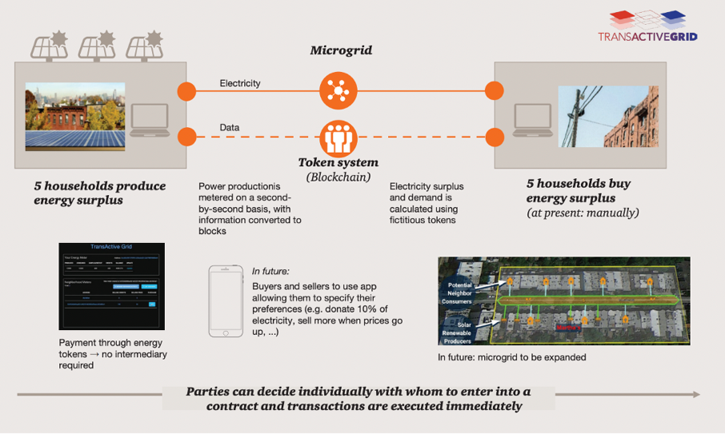
2.2 Industrial Use-Cases from the Energy Sector
The Brooklyn Microgrid is a blockchain-based P2P energy trading platform that is run by Transactive Grid. Transactive Grid is a partnership between LO3 Energy, Consensys, Siemens and Centrica. This microgrid is located in the Gowanus and Park Slope communities in Brooklyn, New York. It has successfully completed a three-month trial run of P2P energy trading between community members in Brooklyn.
With Microgrid, prosumers can sell their energy surplus directly to their neighbors. This is achieved by the use of Ethereum-based smart contracts and the so-called practical Byzantine Fault Tolerance (PBFT) consensus mechanism. The first trial included 5 prosumers and 5 neighboring consumers and resulted in the first-ever energy transaction recorded in blockchains worldwide. The energy surplus is measured by smart meters that can conduct physical energy measurements and record data, and sequentially transformed in equivalent energy tokens that can be traded in the local marketplace. Tokens indicate that a certain
amount of energy was produced from the solar panels and can be transferred from a prosumer's smart meter wallet to end-consumers via blockchain. Tokens are burned by the consumer's smart metering device, as purchased energy is used in the house. Microgrid users interact with the platform by specifying their individual price preferences in the form of willingness to pay or sell electricity. The platform can display location-specific and real-time energy prices. In the initial phase of the project, users manually trigger an agreement in the platform, whose terms are recorded in the blockchain. The ledger records contract terms, transacting parties, volumes of energy injected and consumed as measured by metering devices and crucially the chronological order of transactions. In addition, payments are automatically initiated by self-executed contracts. Every member of the community can have access to all historic transactions in the ledger and verify transactions for themselves.
Figure 8: BrookylnGrid project (Source: Microgrid, 2022)

Slide 22
During the trial phase, more than 300 houses and small businesses, including around 50 prosumers and one small wind turbine generator, have signed for the next phase of development, which aims to achieve fully automated transactions. In the next iteration, Microgrid members can not only decide whom to buy/sell energy tokens based to or from on their price preferences, but also on other criteria that reflect their environmental or social values. For instance, a consumer can specify the maximum price he is willing to spend on locally produced renewable energy, but he can also declare other preferences such as percentage of energy they are willing to purchase from local renewable energy or the main grid. Users can even prioritize selling/buying energy from friends, family, or a specific neighbor. The market clearance mechanism is supposed to work similarly to how stock markets work today:
1
The platform will record the interest of buyers and sellers (bids/offers) in an order book. Users will be able to change their price preferences in real-time.
The locally produced energy will be first allocated to the highest bidders.
3
The lowest allocated bid represents the market clearing price for each time slot, currently set 15 min intervals.
Users will be able in the future to collect historic information on prices, and therefore learn and adapt their bidding strategies.
2
4
Uncertainties & unanswered questions
The Brooklyn MicroGrid project says that it aims to serve as a testbed for exploring novel business models that promote consumer engagement in community projects. Localized energy trading opens the potential for energy cost savings, however, numerous research questions are open for debate. First and foremost, the importance and size of local energy trading markets need to be investigated. Only by implementing large- scale projects that represent diverse conditions in energy markets and social groups, will an accurate determination to participate in similar market architectures be made possible. Pricing in customer-sided markets is determined by the laws of demand and supply, resulting potentially in significant price volatility or even higher tariffs than the ones offered by the main grid. As a result, further work in engagement with and protection of the elderly, socially disadvantaged, and vulnerable from price volatility is required. In addition, equilibrium prices will not only be derived by simple cost functions but by social values and behavior. As a result, individual preferences and social behavior of market participants require further investigation to develop efficient market designs and pricing mechanisms. Other open research questions include the determination of most appropriate time frame for market clearance and data
updates, which is increasingly dependent on the operating protocol rules and consensus. Another crucial issue is that of balancing demand to supply. Currently, existing network infrastructure is used not only to distribute and supply the energy traded in the marketplace, but also to resolve issues caused by RES (a large renewable energy company) intermittency and load balancing.
The future of Microgrid
In the future, the project aims to explore how blockchain could be used for active management of the distribution network. In principle, energy produced by local prosumers can provide additional flexibility for local substation balancing. This is currently not realized in the Brooklyn Microgrid case, although a number of projects have begun exploring the use of techniques from artificial intelligence, machine learning and big data analytics to achieve demand-side flexibility. What blockchains could contribute these solutions is the potential for decentralized matching between prosumers, enabling them to take real-time control of the own energy generation and supply. Please note that MicroGrid has been chosen for the sole purpose to display an existing industrial use case in the energy-sharing economy and is not an endorsement of the company or the project.

Slide 23
03
LEARNING ASSESSMENT FOR MODULE 2

Slide 24

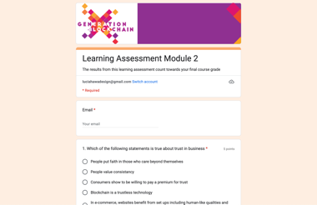
To test your knowledge, finish this learning assessment as part of your overall grade for the course.
Click here.
CLICK TO VIEW

Slide 25

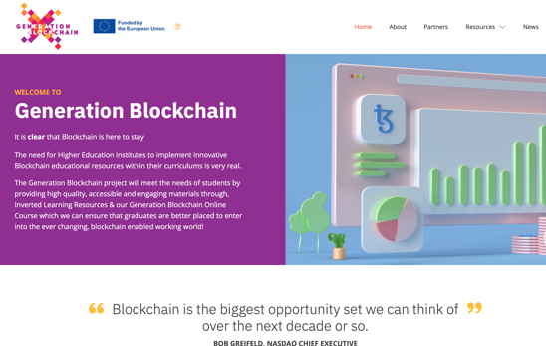

follow your journey
www.generationblockchain.eu

